Slide 1
Sorted squared array
2023/03/04

Slide 2
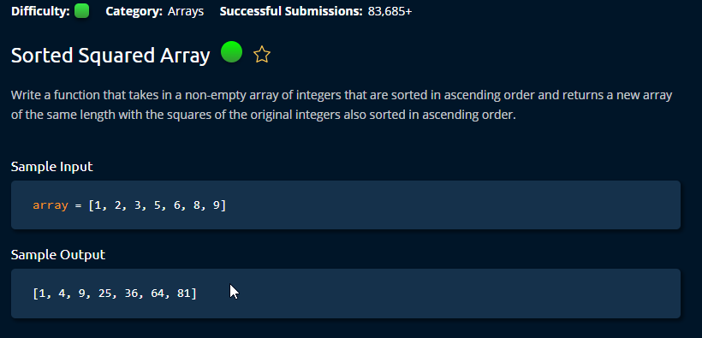

Slide 3
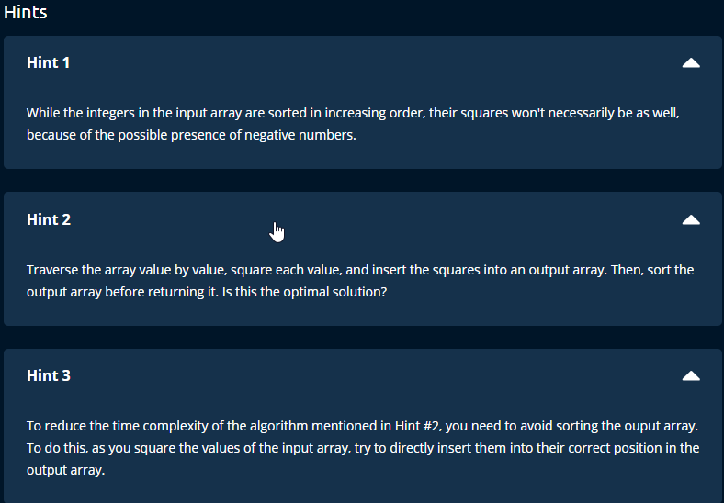

Slide 4
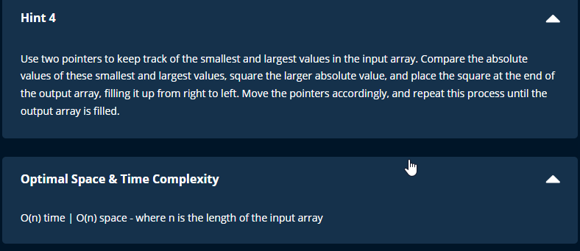

Slide 6
Time and Space complexity
If sort function is used,
Time = O(nlog n)
Space = O(n) : crate a new array
Else:
Time = O(n) : go through the array only once.

